Slide 1
Lecture:11 Template in C++ and Exception Handling
Prepared By: Sumaiya Binte Shahid
Lecturer
Department of CSE, BUBT

Slide 2
Templates in C++
C++ template is a powerful tool that allows you to write a generic code that can work with any data type. The idea is to simply pass the data type as a parameter so that we don't need to write the same code for different data types.
For example, same sorting algorithm can work for different type, so rather than writing and maintaining multiple codes, we can write one sort() and pass the datatype as a parameter.

Slide 3
Templates in C++
Define Templates
Templates can be defined using the keywords "template" and "typename" as shown:
template <typename A, typename B, ...>
entity_definition
The template keyword is used to define that the given entity is a template
typename keyword is used to define template parameters which are nothing but types that will be provided when an instance is created.
The keyword typename can be replaced by keyword class anytime.

Slide 4
Function Templates in C++
The above syntax can define templates for three components (entities) of C++ language:
Function Templates
Class Templates
Variable Templates (Since C++ 14)
In C++, templates allow us to write generic code for functions that can be used with different data types, and this can be achieved by function templates.
For example, we can write a function that gives you the maximum of two numbers, but it can accept any number whether it is int, float, or double.

Slide 5
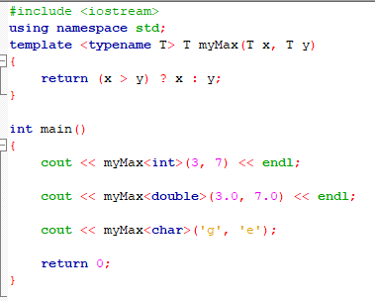
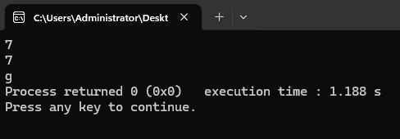
Function Templates in C++

Slide 6
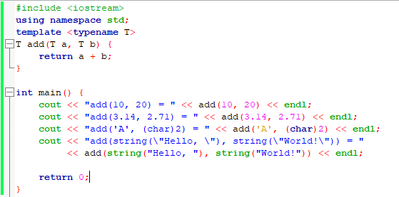
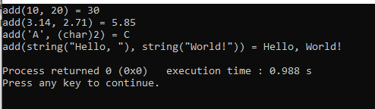
Function Templates in C++

Slide 7
Write a C++ program using class templates to create a generic Circle class that can store the dimensions (radius) of a rectangle for any numeric data type (such as int, float, or double). The class should include a constructor to initialize the attribute and a member function area() to calculate and return the area. In the main() function, create two circle objects: one using integer values and another using double values, and display their areas.

Slide 8
#include <iostream>
using namespace std;
template <class T>
class Rectangle {
private:
T length, width;
public:
Rectangle(T l, T w) {
length = l;
width = w;
}
T area() {
return length * width ;
}
};
int main() {
Rectangle <int> box1(3, 4);
cout << “Area of int box: " << box1.area() << endl;
Rectangle <float> box2(3.5, 4.2);
cout << “Area of float box: " << box2.area() << endl;
return 0;
}

Slide 9
What is a C++ Exception?
In C++, exceptions are runtime anomalies or abnormal conditions that a program encounters during its execution. The process of handling these exceptions is called exception handling.
Using the exception handling mechanism, the control from one part of the program where the exception occurred can be transferred to another part of the code.
So basically using exception handling in C++, we can handle the exceptions so that our program keeps running.
Exception occurs during the running of the program (runtime).

Slide 10
Types of C++ Exception
There are two types of exceptions in C++
Synchronous: Exceptions that happen when something goes wrong because of a mistake in the input data or when the program is not equipped to handle the current type of data it’s working with, such as dividing a number by zero.
Asynchronous: Exceptions that are beyond the program’s control, such as disc failure, keyboard interrupts, etc.

Slide 11
C++ try and catch
C++ provides an inbuilt feature for Exception Handling. It can be done using the following specialized keywords: try, catch, and throw with each having a different purpose.
Syntax of try-catch in C++
try { // Code that might throw an exception throw SomeExceptionType("Error message"); } catch( ExceptionName e1 ) { // catch block catches the exception that is thrown from try block }

Slide 12
C++ try and catch
1. try in C++
The try keyword represents a block of code that may throw an exception placed inside the try block. It’s followed by one or more catch blocks. If an exception occurs, try block throws that exception.
2. catch in C++
The catch statement represents a block of code that is executed when a particular exception is thrown from the try block. The code to handle the exception is written inside the catch block.
3. throw in C++
An exception in C++ can be thrown using the throw keyword. When a program encounters a throw statement, then it immediately terminates the current function and starts finding a matching catch block to handle the thrown exception.
***Multiple catch statements can be used to catch different type of exceptions thrown by try block.

Slide 13
Types
Exception Type | When to Use It
invalid_argument | When an argument passed to a function is logically invalid
out_of_range | When an index or value is outside a valid range (like vector access)
length_error | When an operation exceeds the maximum allowed size or length
domain_error | For mathematical domain errors (e.g., sqrt of a negative number)
logic_error | General logic errors in program (base class of above logic-related errors)
runtime_error | For general runtime errors (e.g., I/O failure)
overflow_error | Arithmetic overflow (e.g., result too large to store)
underflow_error | Arithmetic underflow (e.g., result too small to represent accurately)

Slide 14
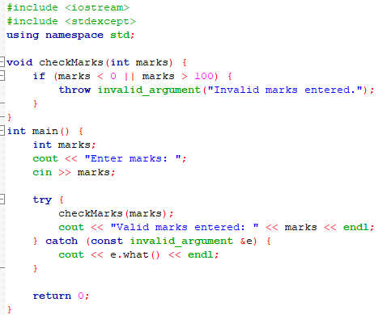
Problem: Write a program that takes the marks of a student as input. If the marks are less than 0 or greater than 100, throw an exception and handle it to ensure valid input.

Slide 15
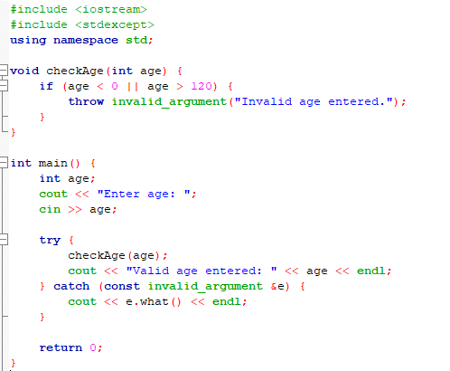
Write a program that takes the age of a person as input. If the age entered is negative or greater than 120, throw an exception and print "Invalid age entered." Handle this exception to ensure valid age input.

Slide 16
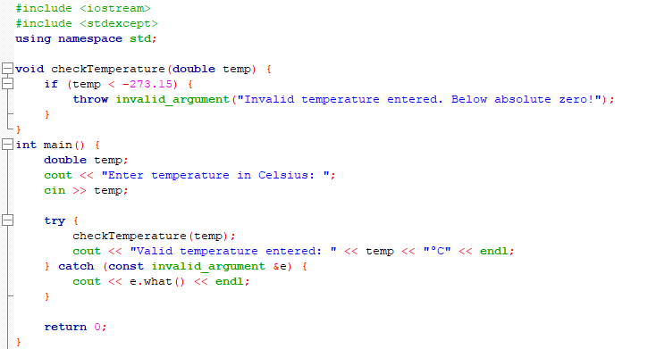
Problem: Write a program that takes a temperature input in Celsius. If the temperature is less than -273.15 (absolute zero), throw an exception and handle it to ensure valid input.

Slide 17
Why do we need Exception Handling in C++?
The following are the main advantages of exception handling over traditional error handling:
Separation of Error Handling Code from Normal Code: There are always if-else conditions to handle errors in traditional error handling codes. These conditions and the code to handle errors get mixed up with the normal flow. This makes the code less readable and maintainable. With try/catch blocks, the code for error handling becomes separate from the normal flow.
Functions/Methods can handle only the exceptions they choose: A function can throw many exceptions, but may choose to handle some of them. The other exceptions, which are thrown but not caught, can be handled by the caller. If the caller chooses not to catch them, then the exceptions are handled by the caller of the caller.
Grouping of Error Types: In C++, both basic types and objects can be thrown as exceptions. We can create a hierarchy of exception objects, group exceptions in namespaces or classes, and categorize them according to their types.

Slide 18

Thank You

